Slide 1


50 Shades of Data
Lucas Jellema (AMIS)
REAL Meeting - 24th May 2019

Slide 2

BOL - CQRS

Slide 3

Books Online - WebShop
Products
Webshop visits
searches
product details
Orders
Product updates
Read only
On line
Speed is crucial
XHTML & JSON
> 5M visits
Data manipulation
Data Quality (enforcement)
<10K transactions
Batch jobs next to online
Speed is nice
firewall

Slide 4


Nightly generation
DMZ
Webshop visits
searches
product details
Orders
Products
Products
Products
Products
Product updates
Read only
On line
Speed is crucial
XHTML & JSON
> 1M visits
Read only
JSON documents
Images
Text Search
Scale Horizontally
Stale but consistent
Data manipulation
Data Quality (enforcement)
<10K transactions
Batch jobs next to online
Speed is nice
firewall

Slide 5

location
Total Cost of Data Ownership
query patterns
usage
volume
volatility
format
distribution
required consistency
freshness requirements (staleness allowance)
integrity
speed
authorization
ACID demands
ownership
availability
environment
Notes:
Data comes in many shades (at least 50) – variations along many dimensions

Slide 6
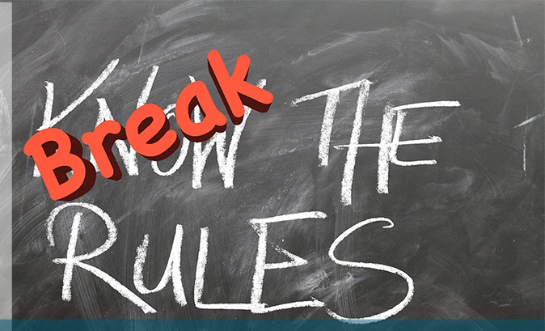
New Rules
DML != Query
Duplication of Data (<> evil)
Data in multiple physical locations
ACID is not an absolute truth
Eventual Consistency (relaxed freshness)
NoSQL – not everything is relational
Data preprocessed, stored and produced for a special consumer
TCO is not a given – and it matters

Slide 7

Why?
Performance
Scalability
Availability
Development productivity
Agility through decoupling
Reduction in TCO

Slide 8

Changing Context
Technology evolution
Capabilities of Databases (SQL and NoSQL)
Hardware (including handheld devices)
Architecture Patterns and new industry insights
Cloud
IoT
Machine Learning
GDPR

Slide 9

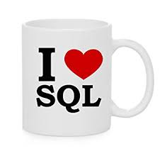
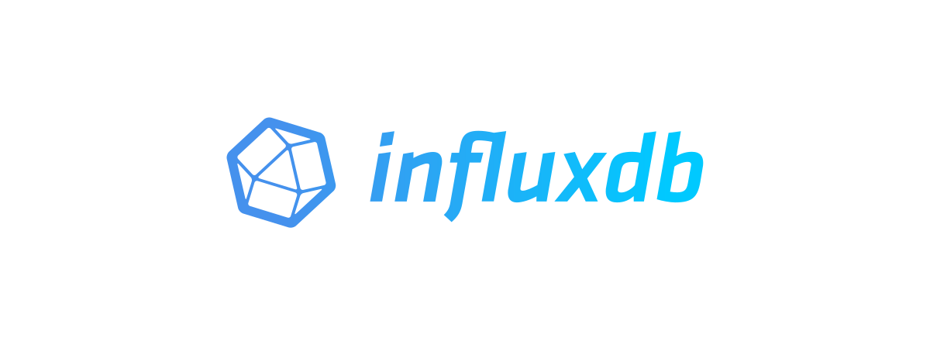


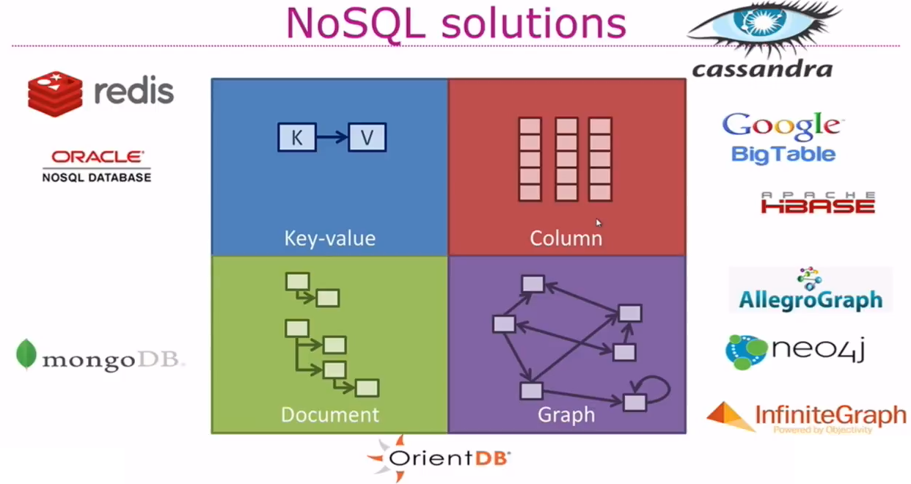



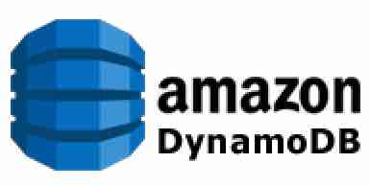



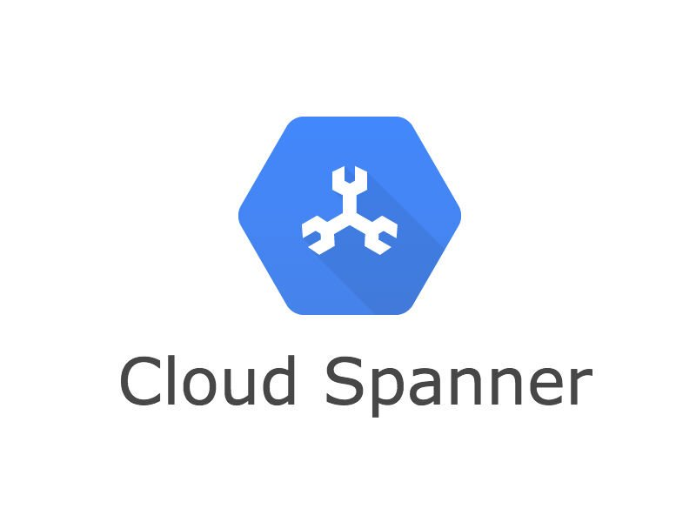


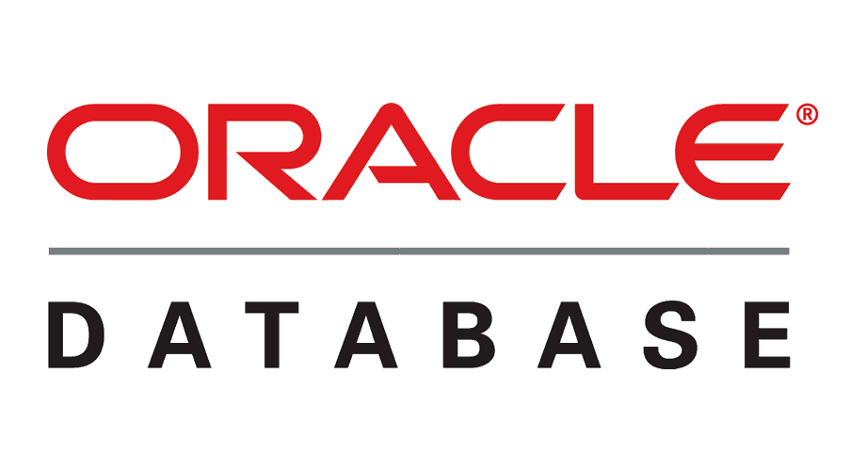











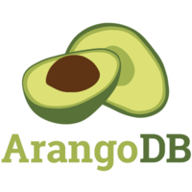



Notes:
technologies

Slide 10
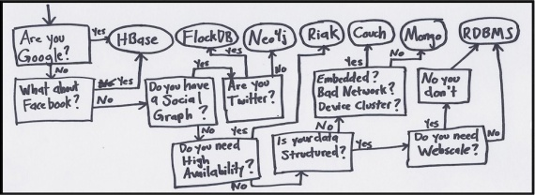
Datastore Selection Criteria
Type of Data (to process and store and produce)
Consistency
Availability (H/A, Fail Over, distributed)
Scalability
Volume, (Peak) Load, “in database processing/wrangling/aggregating”
Usage of Data (to query)
Response Time, Format, Query-style, Number of Queries, Size of Result Set
Security (encrypt, authorize, audit)
Knowledge & Productivity (Dev and Ops) - Managed PaaS
TCO (licence, infra, operating costs, expertise, support)
Technical Fit (fits in OS, Containers, Integration, Monitoring, development framework, CD Pipeline)
“Aliveness”, Roadmap, Community, Marketshare, Resources & Support, Status
Notes:
https://kukuruku.co/post/the-simplest-way-to-choose-nosql-database/

Slide 11
CQRS
Products
Data Manipulation
Data Retrieval

Slide 12

Same Data, Multiple – different – Usage Scenarios
Different in:
Why
What – grain, aggregation, breadth, type of and variation in queries
How – format, language, accuracy and freshness, consistency
When – frequency, time of day | week | month, 24/7
Where – latency, band width, off line
Who – scale, different roles & user groups

Slide 13





CQRS: Command Query Responsibility Segregation
Products
Data Manipulation
Quick Product Search Index
Special Products
Data Retrieval
Toys
Product Clusters
Product Store in SaaS app
Food Stuff
Notes:
Data manipulation and retrieval in separate places
(physical data proliferation)
Query store is optimized for consumers
Level of detail, format, filters applied
For performance and scalability, independence, productivity lower license fees and lower TCO, security

Slide 14
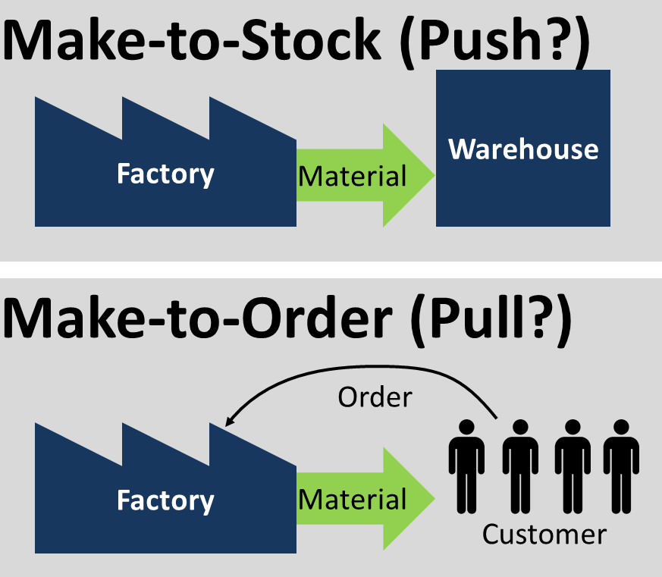
JIT vs AOT

Slide 15
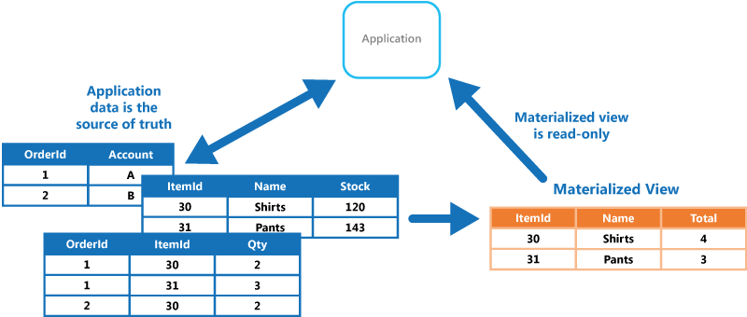
Ahead of Time
Prepare products Ahead of Time instead of upon request
When the time to deliver (to request) is too long
When the complexity of a JIT-approach is too high
When the capacity does not allow for JIT-peak production
When the overhead and waste of AOT are justified

Slide 16
JIT vs AOT Data Integration
JIT
Process [synchronous] request for data ‘just in in time’
Only data that is requested
Fresh as can be
All authorization rules applied
Single Source of Truth
Transformation & Aggregation at request time
Hard (runtime) dependencies from consumer on producer
AOT
Pre-process / pre-share data ‘ahead of time’
Potentially includes data that will never be requested
Data can be outdated

Slide 17

Final Demo
Microservices
Microservice

Slide 18
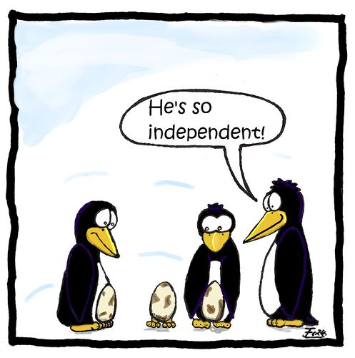
Microservices
Agile | Flexible | Scalable | (Re)Deployable
Independent | Decoupled | Isolated
Communicate asynchronously, via events
Have their own private bounded context – the data they require to function
Their lifeblood

Slide 19
Bounded context of microservices
A micoservice needs to be able to run independently
It needs to contain & own all data required to run
It cannot depend on other microservices
UI
API
Customer
API
Order
CustomerModified event

Slide 20
Event Sourcing

Slide 21
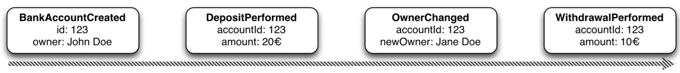


Event Sourcing Driving CQRS
amount: 10
Owner: Jane Doe
Events
Current State
Event Store
accountId: 123
Notes:
Events are immutable facts
Current state (active record) is derived from sum of events
Read optimized aggregates are created for specific use case – based on events and rebuildable at any time

Slide 22
Event Sourcing Driving CQRS
Events
Current State
Event Store
Other State Aggregate
Notes:
Events are immutable facts
Current state (active record) is derived from sum of events
Read optimized aggregates are created for specific use case – based on events and rebuildable at any time

Slide 23
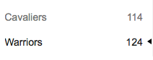

Event Sourcing
Event Store is immutable – append-only log of domain state transitions
Replay events
to (re)construct a representation of the current state (aggregate)
up to a specific time to recreate moments in time
in Test environment to investigate an issue
on a remote location to create mirror & share state across boundaries
produce a fine grained audit trail
Challenges
Time required to reconstruct state
Grain of aggregates / definition of domain events

Slide 24
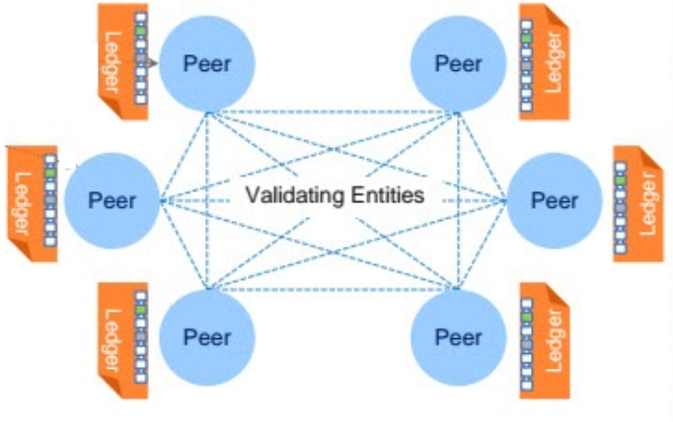

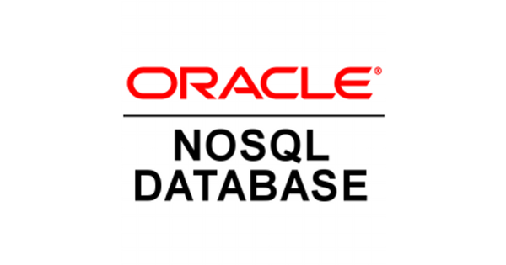


Distributed Database with Event Sourcing & Current State
Transaction
World State
Notes:
Blockchain!

Slide 25
Consequences & Conclusions

Slide 26
Consequenes & Conclusions
More focus on Domain Driven Design
Multiple Data Stores in a solution design | on a project | in an application landscape
Data replicated between data stores (CQRS)
In an event based manner
Knowledge and Skills around multiple data stores
Design and Develop
Secure, Configure and Operate

